Slide 1
Columbus HOPE Workshop
August 21, 2021

Slide 3


Slide 5
Fundraising Agenda
Columbus HOPE Ignite Briefing - 5 min
Fundraising Fundamentals – 5 min
Resources
  Handbook – 10 min
  Website to include the Fundraising Resource Page – 5 min
Open Discussion – Success Secrets, Challenges , Srategies and Actions
  Chris Pate – Council 7129 Greenwood
  John Davis – Council 8295 Anderson
  Joe Balotti – Council 5194 Myrtle Beach
  Alan Chambers - Council 6726 Hanahan – Goose Creek
  Jerry Schmid - Council 6684 Seneca
  Ken Rysavy – Council 15960 Newberry (small Council)
COVID-19 Best Practices Fundraising Discussion Summary

Slide 6
Fundraising Fundamental
The Knowledge:
Know what the Columbus HOPE Foundation does and where the money you raise will go.
Enthusiasm and persistence:
Your enthusiasm will encourage people to support you. Sell the idea! Both internal to your organization and to your community.
There will be plenty of “Nos”. Be prepared for this and don’t let it dampen your enthusiasm.
Confidence:
You must be confident and direct. People need to see that you believe in what you are doing. Remember if you don’t ask you don’t get.
Organization:
Draw up a plan of attack - see our Fundraising Strategic and Planning section in this Handbook. Give yourself plenty of time and set yourself achievable targets.

Slide 7
Fundraising Fundamental (continued)
Contacts and networking:
List everyone you know and how they might help you. You will be surprised how this can help.
Don’t forget to include past donors, sponsors and volunteers
Nurture, nurture, and then nurture some more
Imagination:
The more unusual and attractive your fundraising ideas are; the more people will support them. Not everyone will donate money, perhaps they could donate a prize for a raffle or something for sale on eBay or at a rummage or other sale.

Slide 9
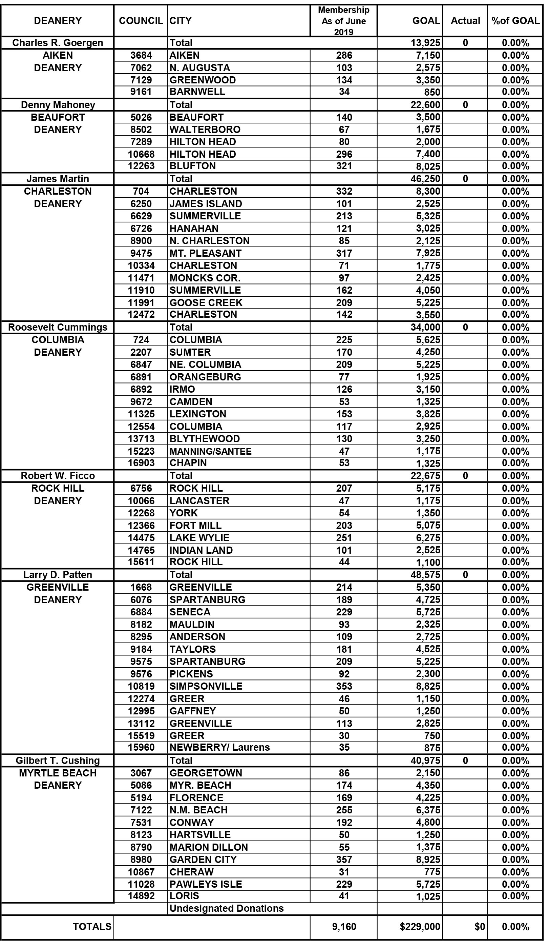
Revised Award Goals
50% of 2022 Goals
Council – Foundation Allocation
85/15% Split Council - CHF
TBD

Slide 10
Revised Award Goals
50% of 2020 Goals
Council – Foundation Allocation
85/15% Split Council - CHF
TBD

Slide 11
Contents
Executive Summary
Fiscal Year 2021 Fundraising Goals
Contents
About Columbus HOPE
Fundraising Basics
Before You Start
Our Core Fundraising Program
Tootsie Roll Fundraising Event Planning
Tootsie Roll Campaign Suggested Planning Timeline
Second or More Fundraising Sources
Fundraising Ideas
Fundraising Strategy Development and Planning
Internet Fundraising Basics and Support
Corporate Donors and Sponsors
Fundraising Policies and Procedures

Slide 12
Contents (continued)
Appendix 1 -Columbus HOPE Foundation Contacts
Appendix 2 - South Carolina Governor’s Proclamation
Appendix 3 – IRS 501(c)(3) Classification Letter
Appendix 4 – South Carolina Registration Letter
Appendix 5 – Tootsie Roll Order Form
Appendix 6 – Fundraising Apron Order Form
Appendix 7 – Fundraising Report CHF 101
Appendix 8 – Fundraising Report CHF 102
Appendix 9 – Fundraising Ideas A-Z

Slide 13
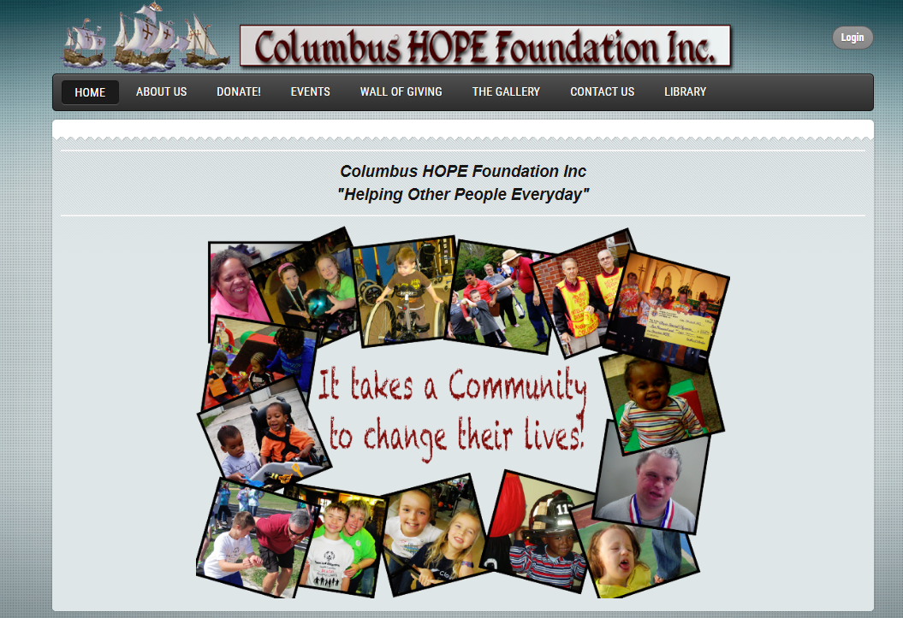

Slide 14
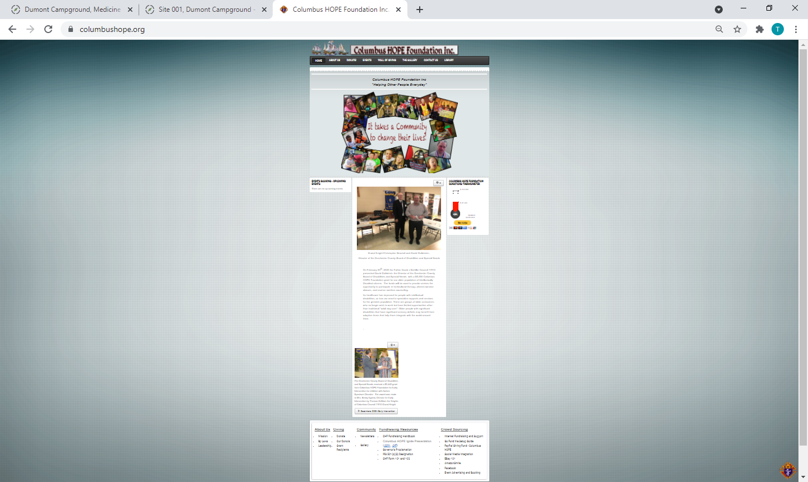

Slide 16
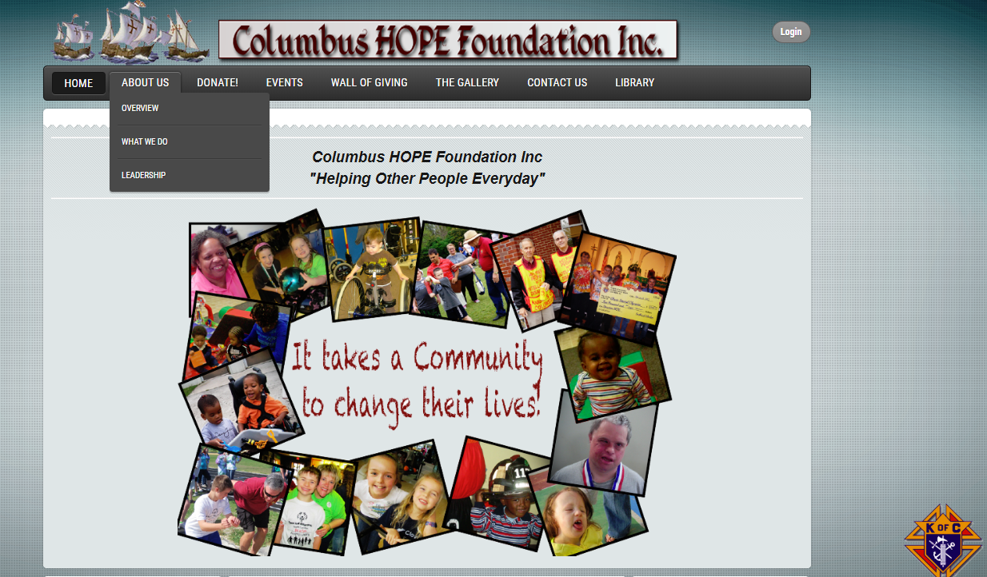

Slide 17
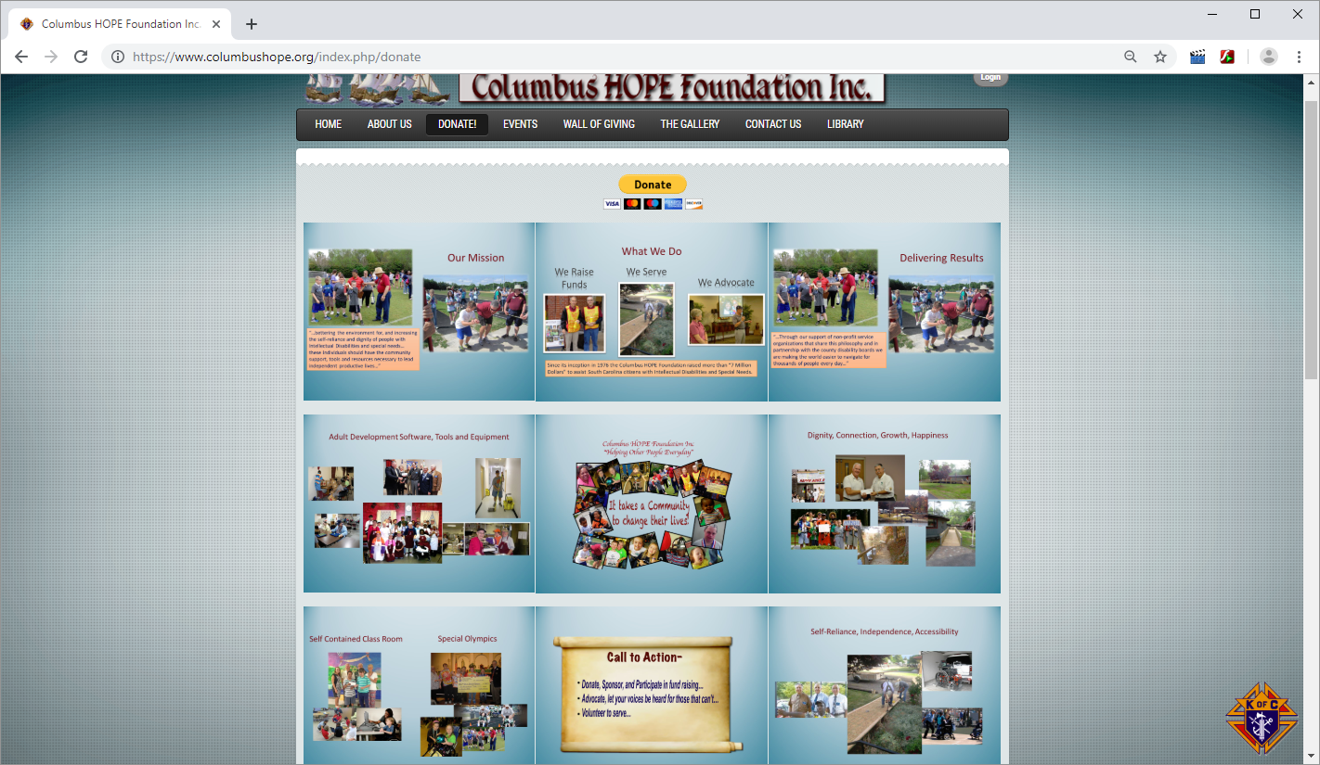

Slide 18
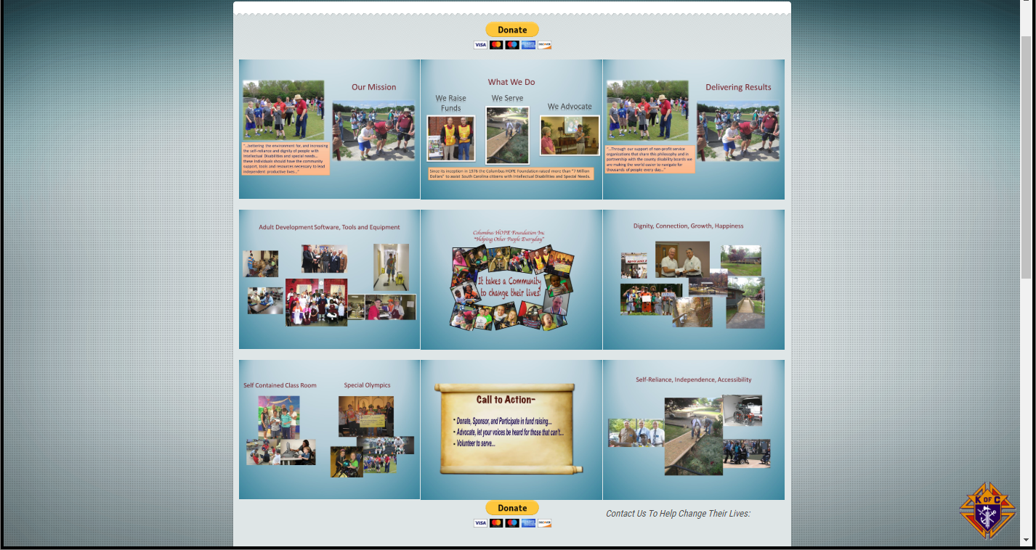

Slide 19
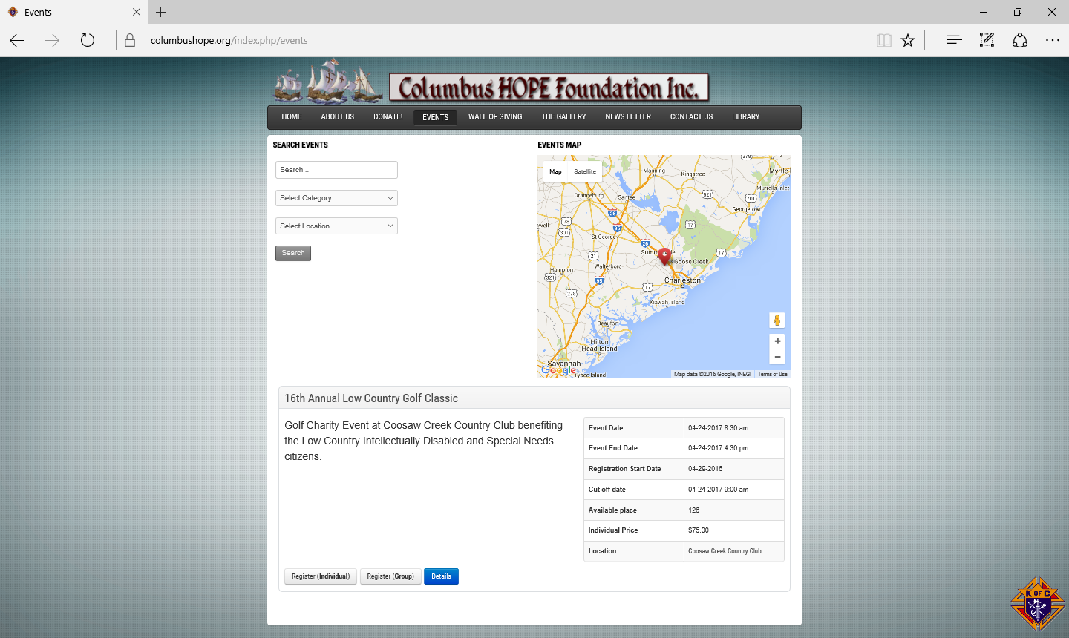
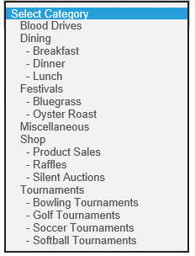

Slide 20
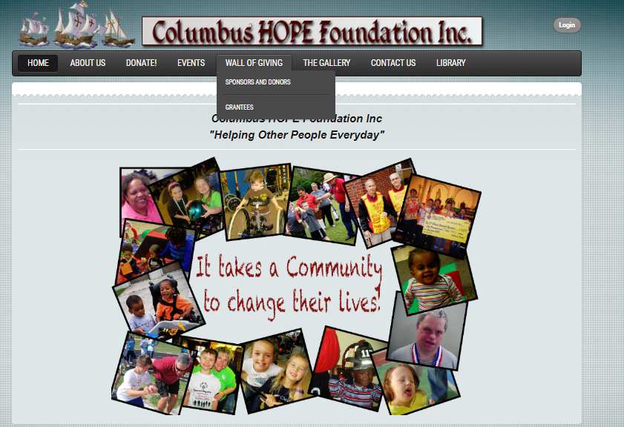

Slide 21
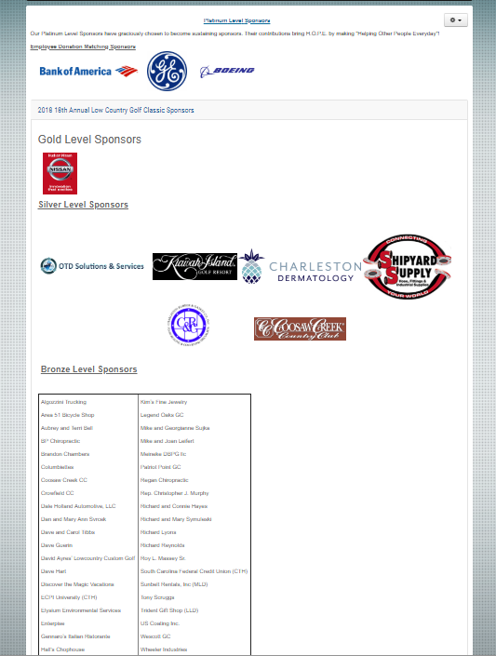

Slide 22
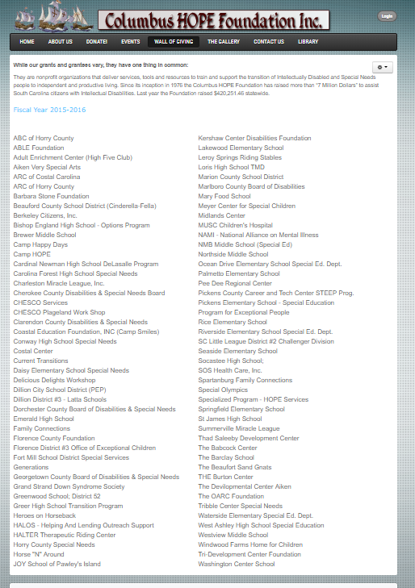

Slide 23
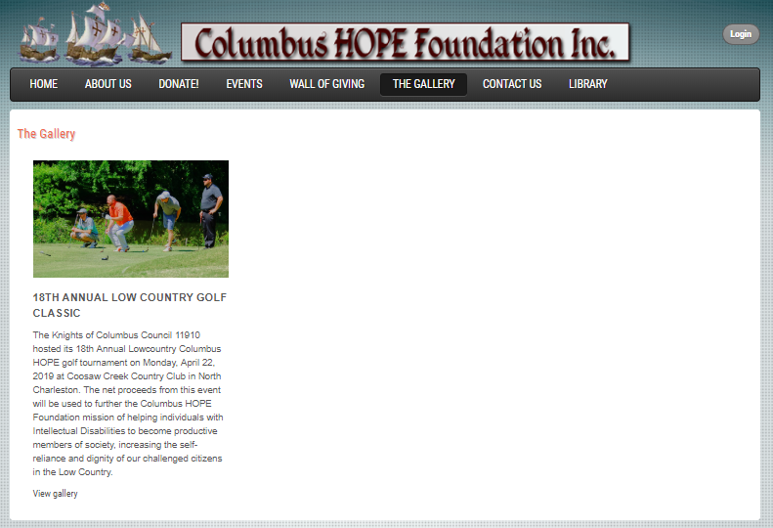

Slide 24
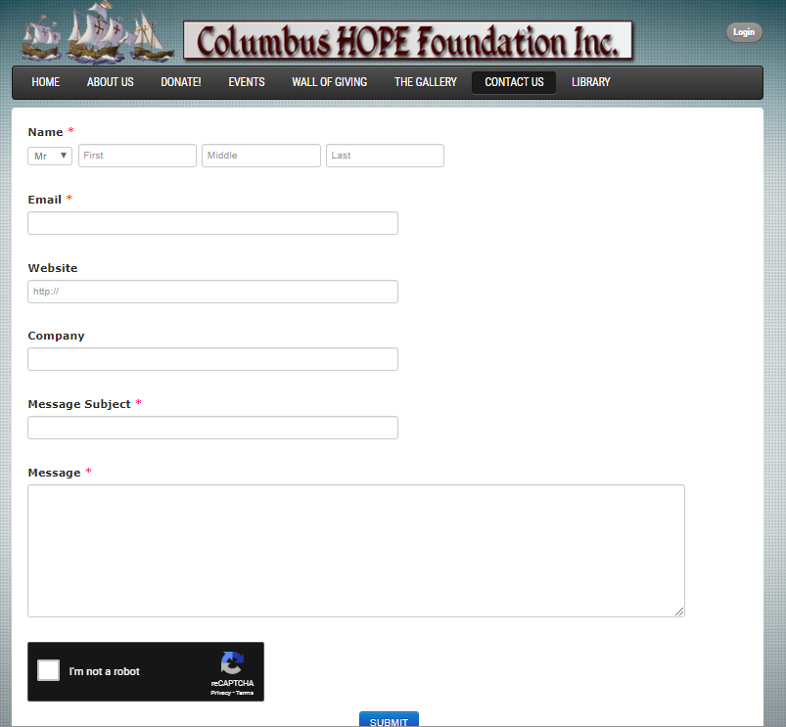

Slide 25
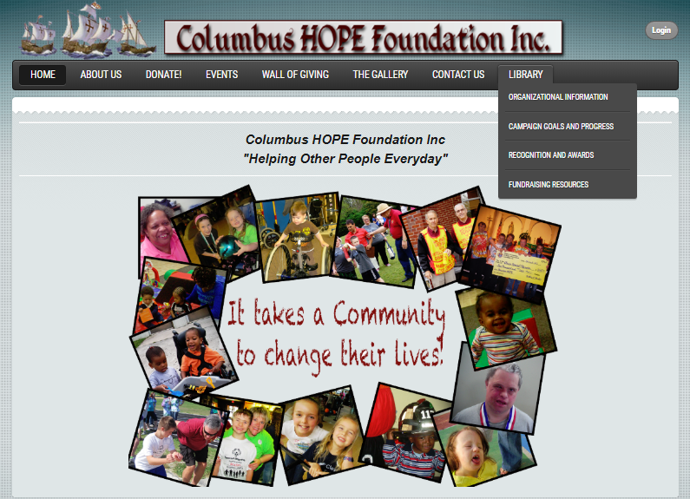

Slide 26
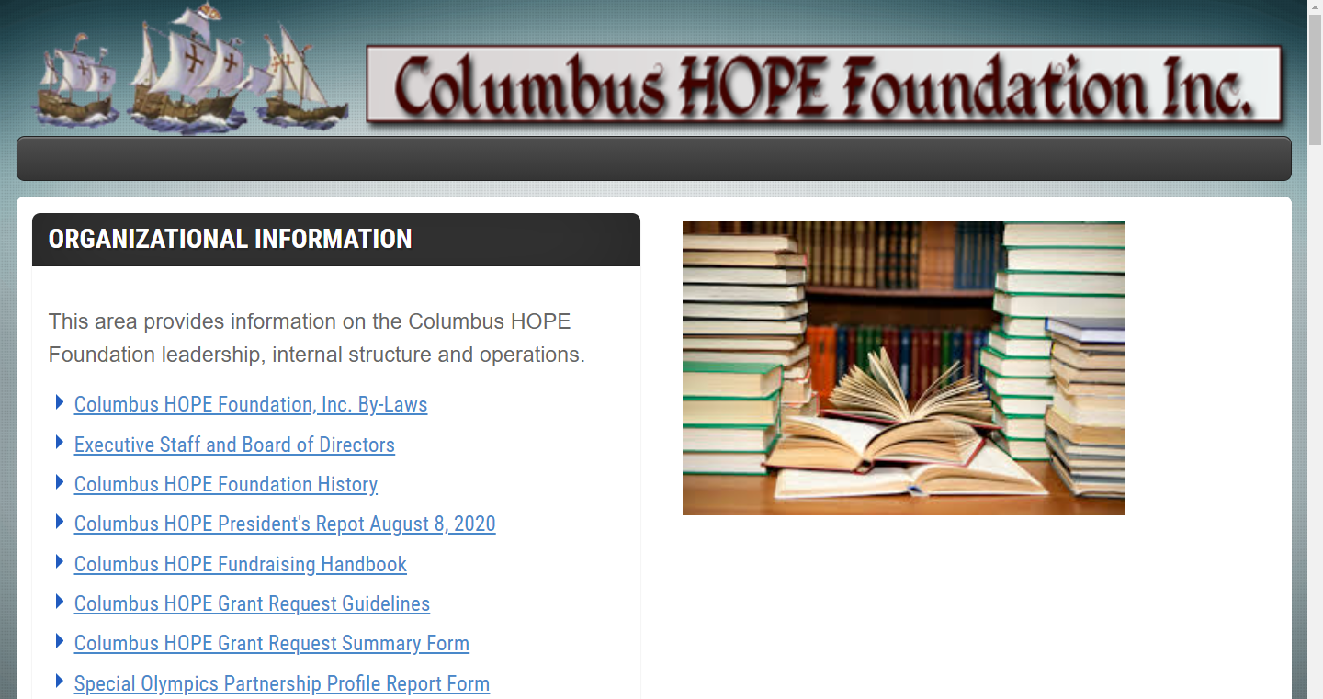

Slide 27
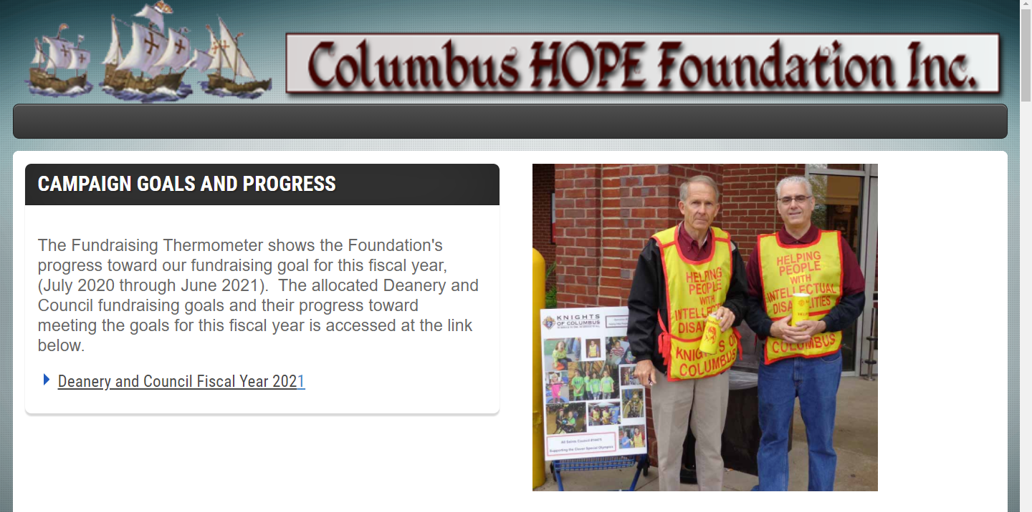

Slide 28
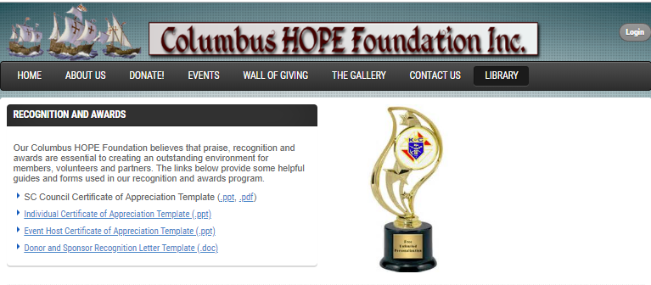

Slide 29
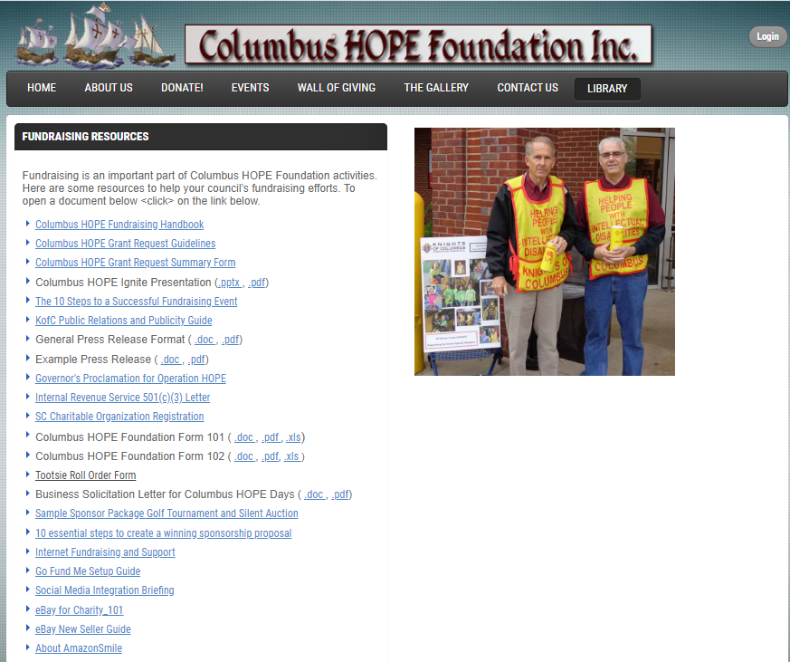

Slide 30
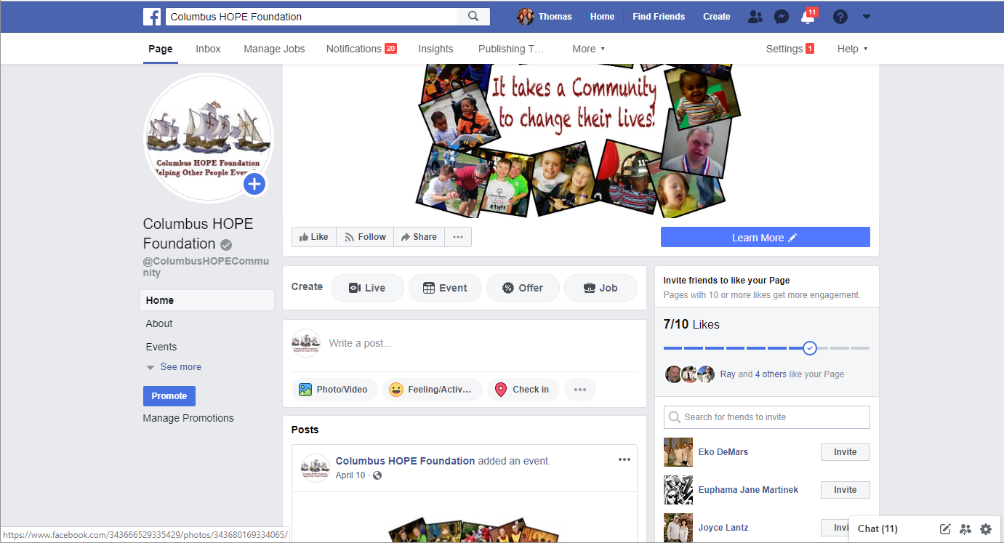

Slide 31
Open Discussion: Success Secrets, Challenges , Strategies and Actions
Chris Pate – Council 7129 Greenwood
John Davis – Council 8295 Anderson
Joe Balotti – Council 5194 Myrtle Beach
Alan Chambers - Council 6726 Hanahan – Goose Creek
Jerry Schmid - Council 6684 Seneca
Ken Rysavy – Council 15960 Newberry (small Council)

Slide 32
What are your Best Practices?
Group Discussion
During COVID-19
G

Slide 33
COVID-19 Fundraising Thoughts
COVID-19 Fundraising Thoughts
Know the CDC and local guidelines;
Set you goals and intermediate objectives;
Rally prospective Sponsors/Donor/Participants and your Council to the cause;
Show your prospective Sponsors/Donor/Participants and your Council how you can achieve your goals and objectives while keeping people safe
Show your prospective Sponsors/Donor/Participants and your Council the impact of in actions.
“Remember the Successful Fundraising Fundamentals”

Slide 34
COVID-19 Fundraising Thoughts (continued)
The Fundraising Fundamentals
The Knowledge:
Know what the Columbus HOPE Foundation does and where the money you raise will go.
Enthusiasm and persistence:
Your enthusiasm will encourage people to support you. Sell the idea! Both internal to your organization and to your community.
There will be plenty of “Nos”. Be prepared for this and don’t let it dampen your enthusiasm.
Confidence:
You must be confident and direct. People need to see that you believe in what you are doing. Remember if you don’t ask you don’t get.
Organization:
Draw up a plan of attack - see our Fundraising Strategic and Planning section in this Handbook. Give yourself plenty of time and set yourself achievable targets.

Slide 35
COVID-19 Fundraising Thoughts (continued)
The Fundraising Fundamentals
Contacts and networking:
List everyone you know and how they might help you. You will be surprised how this can help.
Don’t forget to include past donors, sponsors and volunteers
Nurture, nurture, and then nurture some more
Imagination:
The more unusual and attractive your fundraising ideas are; the more people will support them. Not everyone will donate money, perhaps they could donate a prize for a raffle or something for sale on eBay or at a rummage or other sale.

Slide 37
Columbus Hope Foundation
Fundraising Year 2021-22
Donation Turn-in
Procedures and Grant Requests
Tony Panek, CHF Secretary

Slide 38
Columbus Hope Foundation Secretary Role
Primary Point of Contact with Council CHF Chairman, GK and FS
  Email address: secretary@columbushope.org
Receive and Deposit all Fundraising Monies from Councils
  Directly from Councils (CHF 101 and CHF Check)
  Donors designating funds to a Council (via Tri-Fold Donation Form)
  Donations via PayPal or Go Fund Me campaigns
Track Status and advise Councils of their CHF account
Receive Council’s Grant Requests (CHF 102) and create voucher for Treasurer to cut checks

Slide 39
Review of Columbus Hope Foundation Forms
DEPOSITS: Columbus Hope Foundation Fundraising Report (CHF 101)
GRANTS: Request for Columbus Hope Rebates (CHF 102)
Forms located on columbushope.org website under Library menu

Slide 40
CHF 101 (7/20)

Slide 41
Review of Columbus Hope Foundation Forms
DEPOSITS: Columbus Hope Foundation Fundraising Report (CHF 101)
GRANTS: Request for Columbus Hope Rebates (CHF 102)
Forms located on columbushope.org website under Library menu
Forms are in Word, PDF and Excel formats

Slide 42
CHF 102 (7/20)

Slide 43
KEYS TO ACCURATE FORMS
Complete and accurate forms
  Fill out all blocks of info (Typed or Printed)
  Discard old copies of forms (Names and addresses have changed)
  Signed by Grand Knight
  Minor pen and ink changes fixed by Secretary
Deposits (CHF 101)
  Fillout and send CHF 101 for each deposit council makes (not cumulative)
  Gross amount collected goes towards Council Goal
  Net amount is Gross minus all expenses
  Check sent to Secretary is for the Net Amount (Do not send cash)
  Council grants are based on 85% of net amount
  Council emailed a confirmation letter after each deposit

Slide 44
KEYS TO ACCURATE FORMS
Checks made out to “Columbus Hope Foundation, Inc.”
  No other names like Operation Hope or KoC
  Deposits are in exact amount, not rounded (Net Amount)
Business Donor Checks
  Send checks from businesses made out to Columbus Hope Foundation, Inc. with an appropriate CHF 101
  Business Donation flyers should have their council number on them to ensure that the proper council gets credit for them
  Advise them to include your council number with any direct donations to CHF, to claim credit for the fundraising
  Same for business Matching Fund programs

Slide 45
KEYS TO ACCURATE FORMS
Grant Requests
  Requests made on CHF 102 forms and made out to exact dollar amounts (no cents) and should be at least $500 for each grantee.
  Use deposit feedback letters from the Secretary to know how much money you are entitled to when preparing grant requests or contact me and ask
  CHF Secretary reviews your grant request for completion and accuracy, prepares grant voucher for Treasurer to cut check for President’s signature
  Should have Grant check in ten days from receipt of CHF 102
  Grant Organizations must meet Columbus Hope Foundation mission criteria
    Provide service or support to Intellectually Disabled Citizens of South Carolina

Slide 46
Use CHF Website
For Easiest Way to Get Your Forms and other fundraising tools
columbushope.org

